Slide 1
Superstore Sales

Slide 2
About Superstore dataset:
Sales dataset of a global store for 4 years.
It consists of multiple columns including Profits, Quantity,Cost,Sales , order dates and shipping dates etc.
Creating dashboard using multiple visuals ,KPI ,Page Navigation button to highlight needed for business insights.

Slide 3
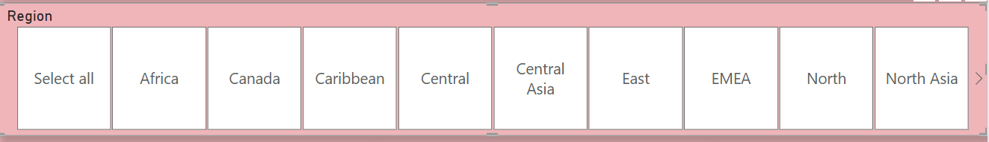
Slicer:
A slicer is an interactive filter in data visualization tools that allows users to dynamically refine and display specific data in dashboards.
Slicers used here as Dropdown for Year,Month and Country display.

Slide 4
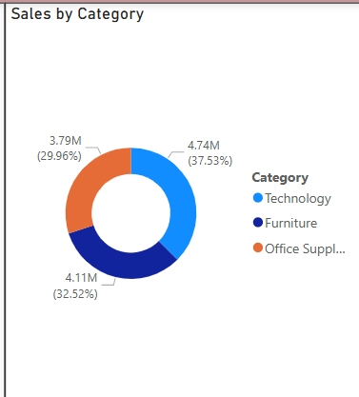
Donut Chart
Visualizing the proportion of categories It shows how each category contributes to the total, as slices of a circle.
This chart used here to show the sales by Category.

Slide 5
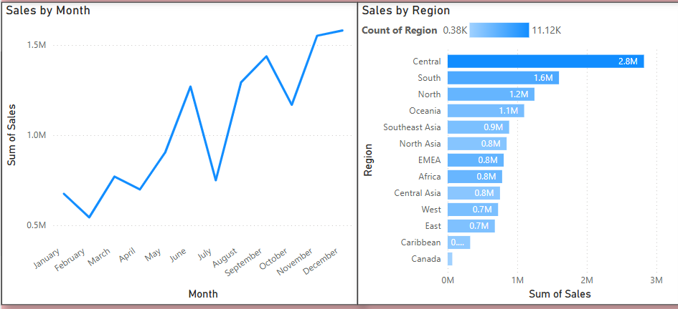
Line chart and Bar chart:
Column chart,Bar chart,Pie chart or Stacked charts used for showing categorical comparisions.
This chart used for comparing monthly sales by category .

Slide 6
Insights:
As per sales by region,Central has highest sales of 2.8m and Canada has lowest sales.
The peak sale in December month of 4 years is
15,80,780.
The highest sales in category is Technology of 4.74m and lowest category is office Supplies.

Slide 7
Thank You

